Slide 1


Korea University
March 25, 2026
EXPLORATORY
DATA ANALYSIS
Customer Churn Prediction in Subscription-Based Telecom Services
Presented by : Team 1
Arij Faiha
Huyngim Eng
Jessica Novita
Shi Xiao Yu

Slide 2
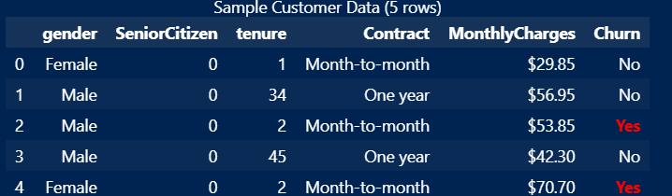
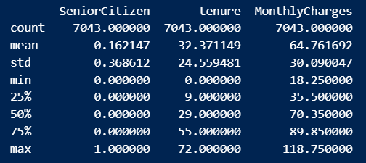
Korea University
March 25, 2026
DATA RECAP
Dataset: IBM Telco Customer Churn
7043 customers, ~21 features (20 variables)
Target: Churn (Yes/No)
Goal: Predict customer churn
1
Raw Data
2
Pre-Processing
3
EDA
4
Data Split
5
Next Step

Slide 3





Korea University
March 25, 2026
DATA RATIONALE
Why this dataset?
Limitation
Widely used and credible
Synthetic Sample Dataset
The IBM Telco dataset is commonly used in churn prediction studies
May not fully reflect the complexity and noise of real telecom customer behavior.
Clear target variable
Possible class imbalance
Supports binary classification with Churn (Yes/No)
Has more non-churn than churn can make models may be biased
Managable size & structure
Limited real world variables
Large enough to achieve statistical significance and detect patterns
Important factors such as customer satisfaction, complaints, or network quality are missing
Business relevant features
No Time Dimension
It includes demographics, tenure, contract, and billing information
Cannot analyze churn over time and track behavior changes or predict when churn happens
Accesible, reproducable & benchmarkable
Easy for all team members to use, replicate, and compare with prior studies
Notes:
Will result for more practical telecom company recently

Slide 4

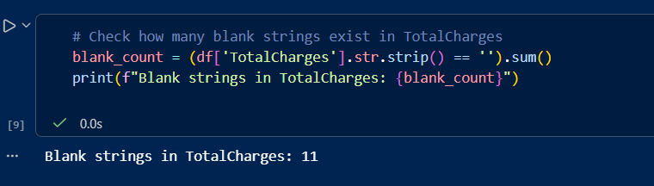
Korea University
March 25, 2026
DATA CLEANING
Missing / Duplicate Check
TotalCharges had 11 blanks.
Replace it with average value.
Type Conversion / Encoding
Converted text (Yes/No, Male,Female) into binary (0/1).
Remove ID variable
CustomerID (not useful).
Result: 49 features ready for machine learning

Slide 5

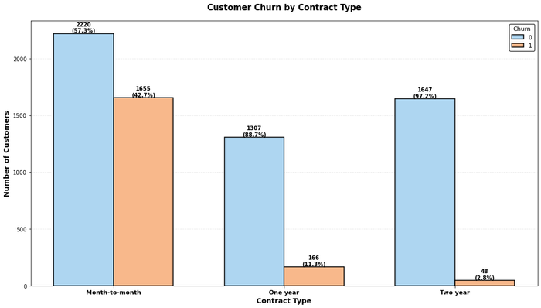

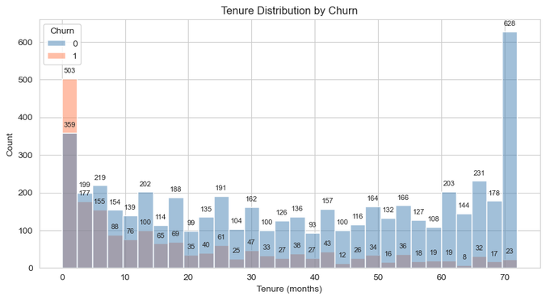
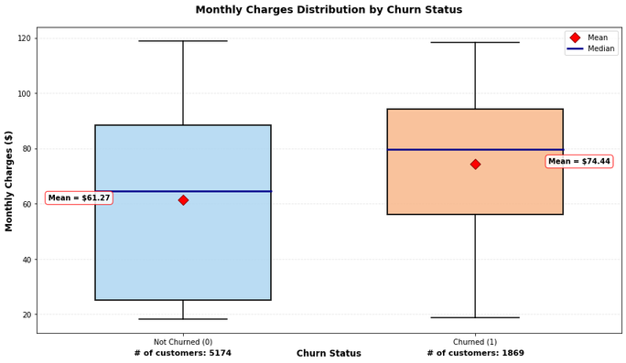
Contract vs Churn
Korea University
March 25, 2026
KEY
FINDINGS
Tenure vs Churn
Contract Type is the biggest driver for churn
Month-to-month: 42.7% churn
2-year: 2.8% churn
Action: Offer discounts for long-term contracts
Customers leave early (first 6-12 months)
Early action needed: onboarding, customer success
Price matters ($61 vs $74/month difference)
High-spend customers are price-sensitive
MonthlyCharges vs Churn

Slide 6
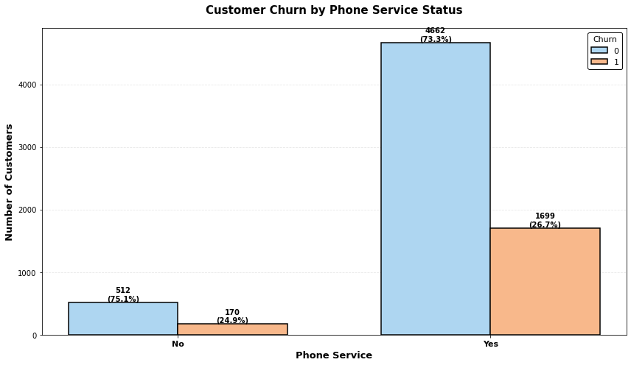
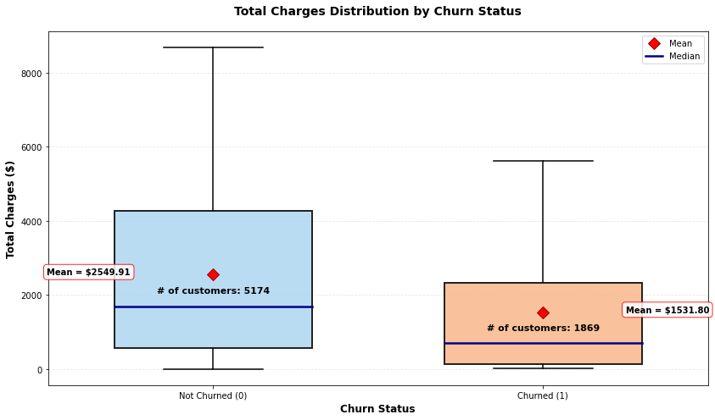
PhoneService vs Churn
Korea University
March 25, 2026
KEY
FINDINGS
Phone Service
Churn rate is nearly identical whether the customer has phone service or not. (~26%)
This variable is not the key drivers of churn.
Total Charges
Churned customers have lower total charges. (shorter lifetime = less spending overall).
High-charge outliers exist in churned group. (likely short-term high spenders who left early).
Total Charges vs Churn

Slide 7

Korea University
March 25, 2026
DATA SPLITTING STRATEGY
DATA STRUCTURE: FEATURES & CHURN
7,043 customers
X = Customer Info (inputs) — 49 features
Tenure, Contract Type, Monthly Charges, Tech Support... + 45 more
y = Churn Result (output) — 1 column
1 = Churned ✗
0 = Stayed ✓
Train
Validation
Test
80%
10%
10%
X=(5634, 49),
y=(5634,)
X=(704, 49),
y=(704,)
X=(705,49),
y=(705,)

Slide 8

Korea University
March 25, 2026
NEXT STEP: MACHINE LEARNING METHOD
Logistic Regression
Simple, fast, & explainable
Random Forest
More accurate & can handle complex pattern
Decision Tree
Easy to visualize the rules

Slide 9
Korea University
March 25, 2026
AI USAGE STATEMENT
This project utilized AI as a supporting tool during the exploratory data analysis phase.
Specific uses included: debugging Python code (Matplotlib, Seaborn, Pandas), clarifying machine learning concepts (one-hot encoding, feature matrix, train/test split).
All data analysis, interpretation of results, business insights, and final decisions were performed independently by the team. All AI-generated suggestions were reviewed, verified, and adapted before use.
AI Tool:
Perplexity AI (Sonnet 4.6)
M365 Copilot AI (Smart Function)
GPT-5.4 Thinking

Slide 10

Korea University
March 25, 2026
THANK YOU!
References
IBM. (2017). Telco Customer Churn [Dataset]. Kaggle. https://www.kaggle.com/datasets/blastchar/telco-customer-churn/data
Richard, R. (n.d.). Telco Customer Churn Analysis Dashboard [Dataset]. Kaggle. https://www.kaggle.com/datasets/reignrichard/telco-customer-churn-analysis-dashboard
Sakib, A. S. (n.d.). Churn Prediction I: EDA & Statistical Analysis [Notebook]. Kaggle. https://www.kaggle.com/code/ahmedshahriarsakib/churn-prediction-i-eda-statistical-analysis#9-Conclusion
McKinney, W. (2010). pandas: Python Data Analysis Library (Version 2.0). https://pandas.pydata.org
Hunter, J. D. (2007). Matplotlib: A 2D graphics environment (Version 3.8). https://matplotlib.org
Waskom, M. (2021). Seaborn: Statistical data visualization (Version 0.13). https://seaborn.pydata.org
Pedregosa, F., et al. (2011). Scikit-learn: Machine learning in Python (Version 1.3). https://scikit-learn.org
Kim, B. (2026). ML Business Applications with Python [Lecture slides]. Korea University Business School, GMBA Program.

